Slide 1


Slide 2
CONGRATULATIONS!
Welcome to the College of Biblical Studies!
We are honored to walk alongside you in this season of learning, growth and transformation. These slides provide a brief orientation and help you prepare to start your first semester. You will be assigned a Student Success Coach who will meet with you to complete the New Student Onboarding process. You will learn to navigate CBS systems and processes, including your email and learning systems.
Keep watch for the symbol, which means you have an
action step to complete.
Action

Slide 3
New Student Onboarding
The goal of New Student Onboarding is to help you successfully start your CBS journey. We want orientation to be an easy process so you can focus on what is most important: learning and growing in Christ through biblical instruction.
Here is what to expect during New Student Onboarding:
Access and Authenticate your CBS Student Email
Receive a Transcript Evaluation and Degree Plan
Meet your Student Success Coach for orientation
Meet your Academic Advisor – your partner all the way to graduation!

Slide 4
Email and Portal Authentication
Upon acceptance for admission, you received an email with instructions to access your new CBS student email. Please access and authenticate your new CBS email before meeting with your Student Success Coach.
Didn’t receive the email? Contact studentonboarding@cbshouston.edu.
Never miss an email – get set up to receive CBS email notifications on your phone. For more information, check out the following links:
ANDROID IOS (APPLE)
Action
Action

Slide 5
Transcript Evaluation and Degree Plan
The transcript(s) you provided during the admissions process are evaluated and transfer credits granted according to CBS guidelines. These credits are applied to the degree plan you chose on your application. Once the evaluation is complete, you will receive a degree roadmap that includes the approved credits and a list of required classes for you to take.
Questions regarding transcript evaluations?
Contact studentonboarding@cbshouston.edu

Slide 6
Student Success Coaches
During your first weeks at CBS, your Student Success Coach will help you navigate the MyCBS student portal, provide resources, answer questions, help you complete your 2-step financial aid process and much more. Your coach will contact you to set up an orientation meeting or you can contact them also.
David Knight: All students enrolled in Spanish programs
Houston/Online students whose last name begins with letters A ̶ J
David.Knight@cbshouston.edu
Sherell Polk: Houston/Online students whose last name begins with letters K-Z
Sherell.Polk@cbshouston.edu

Slide 7
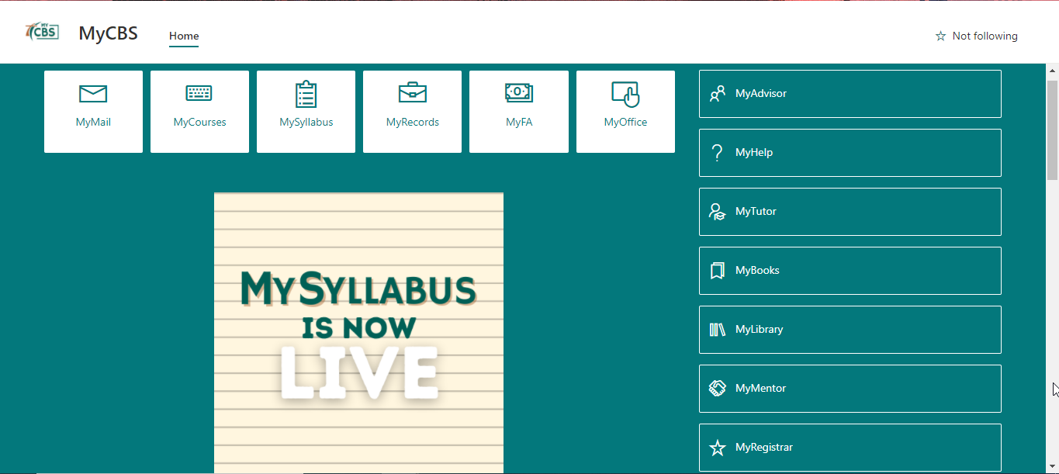
Student Portal
MyCBS is a one-stop location providing total access to everything you need for success. Find MyCBS on our homepage (www.cbshouston.edu) or https://cbshouston.sharepoint.com/sites/MyCBS.

Slide 8
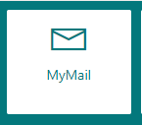
MyMail (CBS Student Email)
Never miss a thing!
Once you follow the steps to authenticate your CBS email, check your email daily by clicking the MyMail icon on the MyCBS Student Portal. This is the way professors, your advisor, Financial Aid and others will contact you.
We recommend using notifications to your cell phone so you will receive CBS email wherever you are! See links below to set that up.
ANDROID IOS (APPLE)

Slide 9
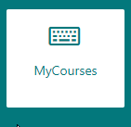
MyCourses (Blackboard)
When you click MyCourses, you will access Blackboard, which is our Learning Management System (LMS).
It is a virtual learning environment and is part of your classroom experience. Whether you take classes online or at one of our campus locations, you will use Blackboard as part of nearly every course.

Slide 10
MyCourses (Blackboard)
What can you do in Blackboard?
Complete a New Student Orientation
Enter a class to access lessons, discussions and journals
Upload assignments for grading
See the syllabus
Keep track of assignments in the gradebook
Email professors with questions (When emailing from Blackboard, the response is sent to your CBS student email)
Click on MyCourses. Locate the New Student Orientation course in the box labeled My Courses. Click on the New Student Orientation course and familiarize yourself with its contents.
Action

Slide 11
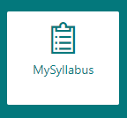
MySyllabus
We recommend ordering your books early and getting a head start on the reading before class begins!
Click on the MySyllabus icon to view and download the syllabus for each class. In the syllabus, you will find the required textbooks, reading requirements and assignments for the course.
Need help locating the right syllabus? Contact your Student Success Coach.

Slide 12
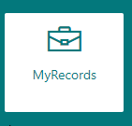
MyRecords (CampusNexus Student or CNS)
Provides your contact information so your advisor, professors, tutors and the Office of Student Financial Services can reach you.
Contains your academic transcript, which is a record of all courses you have taken and the final grade for each course.
Shows your financial aid information, invoices and aid awards.
Allows you to register for classes and view your degree plan.
From the MyCBS portal, click on MyRecords. Verify your contact information is correct. If incorrect, please make changes and Save.
Action

Slide 13
MyRecords (Campus Nexus or CNS
Confirm the degree plan is your intended major. If it is incorrect or you wish to change your major, contact you Academic Advisor, (click MyRecords to view your info and MyAdvisor to find your Advisor)
You will need to provide all outstanding college transcripts during your first semester in order to register for upcoming semesters. Transcripts will be evaluated as they are received and your degree plan updated. Send any additional transcripts to studentonboarding@cbshouston.edu
Action
Action

Slide 14
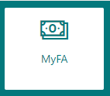
MyFA (Financial Aid Portal)
The MyFA portal provides information about completing the financial aid process, paying for school and links to apply for scholarships.
CBS Financial Aid is a two-part process: complete FAFSA and set up MyFinancialAid, or MyFA, page. Once you complete both parts, our Financial Aid team will process your financial aid documents and provide you with award information.
Click on the MyFA icon. Complete all required financial aid steps.
Questions? Contact fa@cbshouston.edu
Action

Slide 15
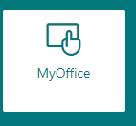
MyOffice (Microsoft Word, PowerPoint and Excel
CBS Students have access to a free online version of Microsoft Office suite which includes Microsoft Office, PowerPoint and Excel.
Click on the MyOffice icon to access this free software.
Questions? Contact your Student Success Coach

Slide 16

MyAdvisor
The MyAdvisor tab provides contact information for your Academic Advisor.
Your Academic Advisor walks with you from your first registration through graduation day. You and your advisor will discuss course selections, life experience credit, graduation prep and other important academic issues.
We encourage you to set up a meeting with your Advisor as soon as possible. Click MyAdvisor for ways to contact your Advisor.
Action

Slide 17

MyHelp
Need help completing your FAFSA?
Have technical issues to resolve?
Forgot your login information?
Help is available to you 24 hours a day, 7 days a week and nearly 365 days a year!
Simply click the MyHelp tab to view resources and select the right option for you.

Slide 18

MyTutor
Need help completing assignments?
Need feedback on an essay or help with citations?
MyTutor is a free service to all CBS students. You can get tutoring help anytime of the day or night. There are dozens of tutoring topics and real tutors available to help you.
Click the MyTutor tab. Create your NetTutor account today so you will have it all set up when you need it.
Action

Slide 19

MyBooks
Order ALL your books for the entire semester at once so you do not risk starting a class without them (too stressful!). Students may order textbooks by clicking the MyBooks tab.
Select your Term, Campus and then Course. Once you have selected all of the courses for the semester, click on View Course Materials to be taken to your shopping cart. Once in the cart, choose the type of book you want to order or “No Thanks” if you do not want to order that particular book. Then proceed to checkout.

Slide 20
MyBooks (MBS Book Ordering System)
CBS students may use the book voucher they can find in their MyFA system, if qualified, to order books through an MBS online system. A book voucher allows a student to use excess financial aid funds to purchase textbooks. To see if you qualify for a book voucher, you must successfully complete all financial aid steps. (Click the MyFA icon to view and complete the necessary steps.)
Once your financial aid is successfully processed, you may request a voucher by using the following link: Book Voucher Allowance | College of Biblical Studies (cbshouston.edu)

Slide 21
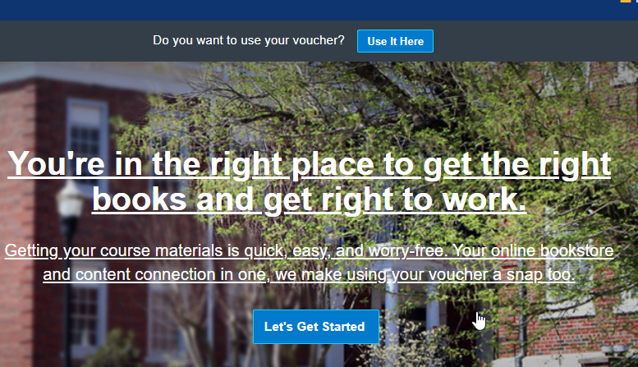
MyBooks (Book Voucher)
The Financial Aid Office will contact you regarding your book voucher. If you qualify, you will receive a voucher ID number that you will use to access the MBS Textbook site.

Slide 22

MyLibrary
Need content for your research papers?
Need help with Turabian citations? Or help accessing online databases?
Click the MyLibrary tab for access to academic research materials and writing help, including the CBS writing style guide.

Slide 23

MyMentor
The Discipleship Team strives to see every student’s CBS experience is not merely an academic endeavor, but a transformational encounter with the Living God! We come alongside each student to help them fulfill Paul’s directive from the Lord to the believers in Rome: “Do not be conformed to this world, but be transformed by the renewing of your mind, so that you may prove what the will of God is, that which is good and acceptable and perfect” (Romans 12:2).

Slide 24
MyMentor
Already have a Mentor?
MyMentor is the place to follow or join the Discipleship department’s Facebook group.
Want to request a Mentor, spiritual support or receive more information?
CBS cares about you! If you want to request a Mentor, are in need of prayer, support, care and comfort, please let us know. Visit: Discipleship | College of Biblical Studies (cbshouston.edu)

Slide 25

MyRegistrar
Ready to graduate?
Want to see the latest courses being offered?
Need to add or drop a class?
MyRegistrar is the place for all academic forms, processes, schedules. You may access semester course offerings, add or drop a class, complete an intent to graduate form and much more.

Slide 26

MyCBS
What comes next?
We are so glad you asked! Here is your first semester checklist.
 | Access your new CBS email (remember to check it daily!)
 | Complete each ACTION item in this Onboarding presentation
 | Meet with your Academic Advisor for registration
 | Meet with your Student Success Coach for a quick orientation
 | Complete the Financial Aid process ( click MyFA for more info)
 | Order textbooks
 | Pray, pray, pray that you may grow deeper in your knowledge and understanding of God’s Word

